Slide 1
Unit Four
Query Processing and Optimization

Slide 2
Introduction
Query Processing
  Activities involved in retrieving data from the database.
  This includes translation of high –level queries into low level expressions that can be used at physical level of the file system, query optimization and actual execution of the query to get the result.

Slide 3
Query Processing…
Aims of query processing (QP):
  Transform query written in high-level language (e.g., SQL), into correct and efficient execution strategy expressed in low-level language that implements relational algebra (RA);
  Execute strategy to retrieve required data.

Slide 4

Basic Steps in Query Processing
1. Parsing and translation
2. Optimization
3. Evaluation
3-<number>

Slide 5
Parsing and translation
Scanner: The scanner specifies and recognizes the language tokens such as SQL Keywords, attribute names, and relation names in the text of the query.
Parser: The parser checks the query syntax to determine whether it is formulated according to the syntax rules of the query language.
Validation: The query must be validated by checking that all attributes and relation names are valid and semantically meaningful names in the schema of the particular database being queried.
3-<number>

Slide 6
Parsing and translation
Query is converted to relational algebra by SQL interpreter.
Relational Algebra converted to annotated tree, joins as branches
Each operator has implementation choices.
Notes:
4

Slide 7
Translating SQL Queries into Relational Algebra
Query block:
The basic unit that can be translated into the algebraic operators and optimized.
A query block contains a single SELECT-FROM-WHERE expression, as well as GROUP BY and HAVING clause if these are part of the block.
Nested queries:
Within a query are identified as separate query blocks.
Aggregate operators in SQL must be included in the extended algebra.

Slide 8
Translation Example
Possible SQL Query:
SELECT balance FROM account WHERE balance<2500
Possible Relational Algebra Query:
πbalance(σbalance<2500(account))
3-<number>

Slide 9
Translating SQL Queries into Relational Algebra
Consider: to find names of employees making more than everyone in department 5.
SELECT lname, fname FROM employee WHERE salary > ( SELECT MAX(salary) FROM employee WHERE dno=5)

Slide 10
Translating SQL Queries into Relational Algebra
2 query blocks:
SELECT lname, fname
FROM employee
WHERE salary > constant
SELECT MAX(salary)
FROM employee
WHERE dno=5
Relational Algebra:
π _{lname, fname} (σ_{salary>cons} (employee))
where cons is the result from:
π _{MAX} _{Salary} (σ_{dno=5}(employee))

Slide 11
Translating SQL Queries into Relational Algebra
consider: to find names of employees making more than everyone in department 5.
SELECT lname,fname, dname FROM employee e, department d WHERE e.dno=d.dno
Relational Algebra:
π _{lname, fname} (employee ⋈e.dno=d.dno department)

Slide 12
Optimization
The query optimizer selects an execution plan that has lowest and fastest but functionally equivalent form.
A relational algebra expression may have many equivalent expressions, each of which gives rise to a different evaluation plan.
Π_{Bala(}σ _{bala>100(Account))}
σ _{bala>100(}Π_{Bala} (Account)) both are equivalent query i.e. they display the same results.
Amongst all equivalent evaluation plans choose the one with lowest cost.
3-<number>

Slide 13
Execution plan
An internal representation of the query is then created, usually as a tree data structure called a query tree.
The DBMS must then devise an execution strategy or plan for retrieving the results of the query from the database files.
A query typically has many possible execution strategies, and the process of choosing a suitable one for processing a query is known as query optimization.

Slide 14
Evaluation
When the query came how the database answer it?
The query-execution engine takes a query-evaluation plan, executes that plan, and returns the answers to the query.
3-<number>

Slide 15
Relational Algebra: overview
Project (unary)
π_{<attr list>} (R)
<attr list> is a list of attributes (columns) from R only
Ex: π_{title, year, length} (Movie) “horizontal restriction”
A₁ A₂ A₃ … A_{n}
A₁ A₂… A_{k}
π
i
j
...
...
n
K, n≥k

Slide 16
Project
PROJECT can produce many tuples with same value
  Relational algebra semantics says remove duplicates
  SQL does not -- one difference between formal and actual query languages

Slide 17
Relational Algebra: Select
Select or Restrict
σ_{<predicate>} (R)
<predicate> is a conditional expression of the type that we are familiar with from conventional programming languages
  <attribute> <op> <attribute>
  <attribute> <op> <constant>
  attribute in R
  op ∈ {=,≠,<,>,≤, …, AND, OR}
Ex: σlength≥100 (Movie) vertical restriction

Slide 18
Pictorially
Movie
title
year
length
filmType
Star Wars
1977
124
color
Mighty
Ducks
1991
104
color
result set
Wayne’s
World
1992
95
color
A₁ A₂ A₃ … A_{n}
A₁ A₂ A₃ … A_{n}
σ
i
j, i ≥ j
...
...
# of selected tuples is referred to as the selectivity of the condition

Slide 19
Cartesian Product
R x S
Sets of all pairs that can be formed by choosing the first element of the pair to be any element of R, the second any element of S.
Resulting schema may be ambiguous
  Use R.A or S.A to disambiguate an attribute that occurs in both schemas

Slide 20
Example
R
S
A
B
B
C
D
A
R.B
S.B
C
D
1
2
x
2
5
6
1
2
2
5
6
3
4
4
7
8
1
2
4
7
8
9
10
11
1
2
9
10
11
3
4
2
5
6
3
4
4
7
8
3
4
9
10
11

Slide 21
Join Operations
Natural Join (binary)
R join S
Match only those tuples from R and S that agree in whatever attributes are common to the schemas of R and S
  If r and s from r(R) and s(S) are successfully paired, result is called a joined tuple
This join operation is the same we used in earlier section to recombine relations that had been projected onto two subsets of their attributes (e.g., as a result of a BCNF decomposition)

Slide 22
Example
R
S
A
B
B
C
D
A
B
C
D
1
2
join
2
5
6
1
2
5
6
3
4
4
7
8
3
4
7
8
9
10
11

Slide 23
Optimization
A relational algebra expression may have many equivalent expressions
  E.g.,σ_{salary<75000}(∏_{salary}(instructor)) is equivalent to
  ∏_{salary}(σ_{salary<75000}(instructor))
Each relational algebra operation can be evaluated using one of several different algorithms
  Correspondingly, a relational-algebra expression can be evaluated in many ways.
  E.g., can use an index on salary to find instructors with salary < 75000,
  or can perform complete relation scan and discard instructors with salary ≥ 75000
3-<number>

Slide 24
Optimization….
Annotated expression specifying detailed evaluation strategy is called an evaluation-plan.
Query Optimization: Amongst all equivalent evaluation plans choose the one with lowest cost.
Cost is estimated using statistical information from the database catalog
  e.g. number of tuples in each relation, size of tuples, etc.
  Total cost= CPU cost + I/O cost + communication cost
3-<number>

Slide 25
Three Key Concepts in QPO
Building blocks
  Similarly, most DBMS have few building blocks:
    select (point query, range query), join, sorting, ...
  SQL query is decomposed in building blocks
Query processing strategies for building blocks
  DBMS keeps a few processing strategies for each building block
    e.g. a point query can be answer via an index or via scanning data-file
Query optimization
  For each building block of a given query, DBMS QPO tries to choose
    “most efficient” strategy given database parameters
    parameter examples: table size, available indices, …
    ex. index search is chosen for a point query if the index is available
3-<number>

Slide 26
Query tree
Query tree: a tree data structure that corresponds to a relational algebra expression. It represents the input relations of the query as leaf nodes of the tree, and represents the relational algebra operations as internal nodes.
An execution of the query tree consists of executing an internal node operation whenever its operands are available and then replacing that internal node by the relation that results from executing the operation.
3-<number>

Slide 27
Tree Representation of Relational Algebra
π_{balance}σ_{balance<2500}(account))
π_{balance}
σ_{balance<2500}
account
3-<number>

Slide 28
Making An Evaluation Plan
Annotate Query Tree with evaluation instructions:
The query can now be executed by the query execution engine.
π_{balance}
σ_{balance<2500}
use index 1
account
3-<number>

Slide 29
Tree Representation of Relational Algebra
π _{A1,,,,An}σ_{p}( R1 x,….Rk))
π_{A1,,,An}
σ_{P}
x
x
Rk
x
R1
R3
R2
3-<number>

Slide 30
Why Learn about QPO?
Why learn about QPO in a DBMS?
  Identify performance bottleneck for a query
    is it the physical data model or QPO ?
  How to help QPO speed up processing of a query ?
    providing hints, rewriting query, etc.
  How to enhance physical data model to speed up queries?
    add indices, change file- structures, …
3-<number>

Slide 31
Measures of Query Cost
Cost is generally measured as total elapsed time for answering query
  Many factors contribute to time cost
    disk accesses, CPU, or even network communication
Typically disk access is the predominant cost, and is also relatively easy to estimate. Measured by taking into account
  Number of seeks * average-seek-cost
  Number of blocks read * average-block-read-cost
  Number of blocks written * average-block-write-cost
    Cost to write a block is greater than cost to read a block
    data is read back after being written to ensure that the write was successful
3-<number>

Slide 32
Algorithms for select operations
Implementing the SELECT Operations
There are many algorithms for executing a select operation , which is basically a search operation to locate the records in a disk file that satisfy a certain condition.
Let as discuss on the ff relational operations.
  OP1: σSSN=“123” (Employee)
  OP2: σDnumber>5 (department)
  OP3: σDno>5 (employee)

Slide 33
Search Methods for Simple Selection
S1.Linear search (brute force algorithm) : Retrieve every record in the file, and test whether its attribute values satisfy the selection condition.
S2. Binary search: If the selection condition involves an equality comparison on a key attribute on which the file is ordered, binary search—which is more efficient than linear search—can be used.

Slide 34
Search Methods for Simple Selection
  S3. Using a primary index : If the selection condition involves an equality comparison on a key attribute with a primary index. for example, Eid = ‘123’ use the primary index to retrieve the record. Note that this condition retrieves a single record (at most).
S4.Using a primary index to retrieve multiple records: If the comparison condition is >,>=,<, or <= on a key field with a primary index—for example, deptname > 5 use the index to find
the record satisfying the corresponding equality condition (deptname= 5), then retrieve all subsequent records in the (ordered) file. For the condition deptname < 5, retrieve all the preceding records.

Slide 35
Search Methods for Simple Selection
S5. Using a clustering index to retrieve multiple records: If the selection condition involves an equality comparison on a non-key attribute with a clustering index—for example, DNO = 5 is use the index to retrieve all the records satisfying the condition.
S6. Using a secondary ( B+ tree) index on an equality comparison: This search method can be used to retrieve a single record if the indexing field is a key (has unique values) or to retrieve multiple records if the indexing field is not a key. This can also be used for comparisons involving >, >=, <, or <=.
3-<number>

Slide 36
Sorting
Efficient evaluation for many operations
Sorting uses keyboard order by:
  SELECT cid,name FROM student ORDER BY name
Implementations
  Internal sorting (if records fit in main memory)
  External sorting

Slide 37
Why Sort?
A classic problem in computing
Data requested in sorted order
  e.g., find students in increasing gpa order
Sorting is useful for eliminating duplicate copies in a collection of records
Problem: If a list is too large to fit in main memory, the time required to access a data value on a disk or tape dominates any efficiency analysis.
E.g sort 10GB of data with 1GB of RAM.
Solution: Develop external sorting algorithms that minimize disk accesses.
3-<number>
Notes:
4

Slide 38
External Sorting
Refers to sorting algorithms that are suitable for large files of records stored on disk that do not fit entirely in main memory.
External sorting handles a massive amount of data. This data may be too big to fit in RAM of the computer device for sorting. So data reside on slower external memory.
The typical external sorting algorithm uses a sort-merge strategy, which starts by sorting small sub files called runs.

Slide 39
Basic External Sorting Algorithm
Assume unsorted data is on disk at start
Let M = maximum number of records that can be stored & sorted in internal memory at one time
Algorithm
Sort phase:
First divide the file into runs such that the size of runs small enough to fit into main memory.
Read M records into main memory & sort internally.
Write this sorted sub-list onto disk. (This is one “run”).
Until all data is processed into runs
Merge phase:
Merge two runs into one sorted run by reading the first block of runs.
Pass first recodes to buffer blocks till buffer block is full
Write this output back to disk
When a block of a run is exhausted next block of the run is read

Slide 40


2-Way Sort: Requires 3 Buffers
Phase 1: PREPARE.
  Read a page, sort it, write it.
  only one buffer page is used
Phase 2, 3, …, etc.: MERGE:
  Three buffer pages used.
Main memory
1 buffer
INPUT 1
1 buffer
1 buffer
OUTPUT
INPUT 2
Main memory buffers
Disk
Disk
3-<number>
Notes:
5

Slide 41
Basic External Sorting
81
94
11
96
12
35
17
99
28
58
41
75
15
Unsorted Data on Disk
Assume M = 3 (M would actually be much larger, of course.) First step is to read 3 data items at a time into main memory, sort them and write them back to disk as runs of length 3.
11
81
94
17
28
99
15
12
35
96
41
58
75

Slide 42
Basic External Sorting
11
81
94
17
28
99
15
12
35
96
41
58
75
Next step is to merge the runs of length 3 into runs of length 6.
11
12
35
81
94
96
17
28
41
58
75
99
15

Slide 43
Basic External Sorting
11
12
35
81
94
96
15
17
28
41
58
75
99
Next step is to merge the runs of length 6 into runs of length 12.
11
12
17
28
35
41
58
75
81
94
96
99
15

Slide 44
Basic External Sorting
11
12
17
28
35
41
58
75
81
94
96
99
15
Next step is to merge the runs of length 12 into runs of length 24. Here we have less than 24, so we’re finished.
11
12
15
17
28
35
41
58
75
81
94
96
99

Slide 45
Example 2
18
11
16
13
12
17
21
15
19
20
14

Slide 46
Sort-Merge Example
pass
run
a
12
d
95
a
12
d
95
a
12
a
12
R₁
d
95
x
44
b
38
x
44
f
12
d
95
s
95
f
12
o
73
e
87
f
12
d
95
o
73
s
95
R₂
f
12
o
73
a
12
s
95
x
44
pass
n
67
t
45
x
44
o
73
file
n
67
e
87
b
38
memory
s
95
e
87
n
67
e
87
R₃
t
45
z
11
t
45
n
67
v
22
v
22
t
45
b
38
x
44
b
38
v
22
R₄
v
22
z
11
z
11
z
11

Slide 47
Implementing the join operation
The JOIN operation is one of the most time-consuming operations in query processing.
Many of the join operations encountered in queries are of the EQUIJOIN and NATURAL JOIN varieties.
The algorithms we consider are for join operations of the form :R join_{A}=_{B} S
Where A and B are domain-compatible attributes of R and S, respectively
3-<number>

Slide 48
Methods for Implementing Joins
J1. Nested-loop join (brute force): For each record t in R (outer loop), retrieve every record s from S (inner loop) and test whether the two records satisfy the join condition t[A] = s[B].
J2. Single-loop join (using an access structure to retrieve the matching records):
If an index (or hash key) exists for one of the two join attributes—say, B of S—retrieve each record t in R, one at a time (single loop), and then use the access structure to retrieve directly all matching records s from S that satisfy s[B] = t[A].
3-<number>

Slide 49
Methods for Implementing Joins
J3. Sort–merge join: If the records of R and S are physically sorted by value of the join attributes A and B, respectively, we can implement the join in the most efficient way possible, in order of the join attributes A and B.
If the files are not sorted, they may be sorted first by using external sorting. In this method, pairs of file blocks are copied into memory buffers in order and the records of each file are scanned only once each for matching with the other file.
unless both A and B are non-key attributes, in which case the method needs indexing. R(i) to refer to the record in R.A variation of the sort-merge join.
3-<number>

Slide 50
Methods for implementing joins
J4. Hash-join: The records of files R and S are both hashed to the same hash file, using the same hashing function on the join attributes A of R and B of S as hash keys.
First, a single pass through the file with fewer records (say, R) hashes its records to the hash file buckets; this is called the partitioning phase, since the records of R are partitioned into the hash buckets.
In the second phase, called the probing phase, a single pass through the other file (S) then hashes each of its records to probe the appropriate bucket, and that record is combined with all matching records from R in that bucket.
This simplified description of hash-join assumes that the smaller of the two files fits entirely into memory buckets after the first phase.
3-<number>

Slide 51
methods of query optimization
There are two methods of query optimization.
1. Cost based Optimization (Physical)
This is based on the cost of the query. The query can use different paths based on indexes, constraints, sorting methods etc.
This method mainly uses the statistics like record size, number of records, number of records per block, number of blocks, table size, whether whole table fits in a block, organization of tables, uniqueness of column values, size of columns etc
3-<number>

Slide 52
methods of query optimization cont…
2. Rule based optimization:
Use heuristics, called query rewrite rules
  eliminate many of the really bad plans
  Rules that will improve performance with very high probability
  Getting queries into a form that we know how to handle best
  This method creates relational tree for the given query based on the equivalence rules.
  When these equivalence rules provide an alternative way of writing and evaluating the query, gives the better path to evaluate the query.
3-<number>

Slide 53
Query Rewrite Rules
Transform one logical plan into another
Do not use statistics
Equivalences in relational algebra
Push-down predicates
Write projects early
Avoid cross-products if possible
Use left-deep trees
Use of constraints, e.g., uniqueness
3-<number>

Slide 54
Query Rewrite Rules
First, move SELECT operations down the query tree
Second, perform the more restrictive SELECT operations first
Third, replace CARTESIAN PRODUCT and SELECT combinations with JOIN operations
Finally, move PROJECT operations down the query tree
This is called heuristic optimization
3-<number>

Slide 55
Example Query
Select B,D
From R,S
Where R.A = “c” ∧ R.C=S.C
3-<number>

Slide 56
Initial Logical Plan
π_{B,D}
Select B,D
From R,S
Where R.A = “c” ∧ R.C=S.C
σ_{R.A = “c” Λ R.C = S.C}
X
R
S
Relational Algebra: Π_{B,D} [ σ_{R.A=“c”∧ R.C = S.C} (RXS)]
3-<number>

Slide 57
Apply Rewrite Rule (1)
π_{B,D}
π_{B,D}
σ_{R.C = S.C}
σ_{R.A = “c” Λ R.C = S.C}
σ_{R.A = “c”}
X
X
R
S
R
S
Π_{B,D} [ σ_{R.C=S.C} [σ_{R.A=“c”}(R X S)]]
Split the conjunction into two select predicates, the order doesn’t matter
3-<number>
Notes:
In order to evaluate R.A we only need from one side push-down

Slide 58
Apply Rewrite Rule (2)
π_{B,D}
π_{B,D}
σ_{R.C = S.C}
σ_{R.C = S.C}
σ_{R.A = “c”}
X
σ_{R.A = “c”}
X
S
R
S
R
Π_{B,D} [ σ_{R.C=S.C} [σ_{R.A=“c”}(R)] X S]
3-<number>

Slide 59
Apply Rewrite Rule (2)
π_{B,D}
π_{B,D}
σ_{R.C = S.C}
σ_{R.A = “c”}
σ_{R.C = S.C}
σ_{R.A = “c”}
X
S
R
S
R
Π_{B,D} [ σ_{R.C=S.C} [σ_{R.A=“c”}(R)] X S]
3-<number>

Slide 60
How do we execute this query?
Select B,D
From R,S
Where R.A = “c” ∧ S.E = 2 ∧ R.C=S.C
- Do Cartesian product
- Select tuples
- Do projection
One idea
3-<number>

Slide 61
R A B C S C D E
a 1 10 10 x 2
b 1 20 20 y 2
c 2 10 30 z 2
d 2 35 40 x 1
e 3 45 50 y 3
Select B,D
From R,S
Where R.A = “c” ∧ S.E = 2 ∧ R.C=S.C
Answer B D
2 x
3-<number>

Slide 62
An Example (cont.)
Plan 1
  Cross product of R & S
  Select tuples using WHERE conditions
  Project on B & D
Algebra expression
π_{B,D}
σ_{R.A=‘c’∧ S.E=2 ∧R.C=S.C}
π_{B,D}(σ_{R.A=‘c’∧ S.E=2 ∧R.C=S.C} (R ×S))
×
R
S

Slide 63
R X S R.A R.B R.C S.C S.D S.E
a 1 10 10 x 2
a 1 10 20 y 2
.
.
c 2 10 10 x 2
.
.
Select B,D
From R,S
Where R.A = “c” ∧ S.E = 2 ∧ R.C=S.C
Found!
Got one...
3-<number>

Slide 64
An Example (cont.)
Plan 2
  Select R tuples with R.A=“c”
  Select S tuples with S.E=2
  Natural join
  Project B & D
Algebra expression
π_{B,D}
π_{B,D}(σ _{R.A=“c”} (R) σ_{S.E=2} (S))
σ_{R.A=‘c’}
σ_{S.E=2}
R
S

Slide 65
Relational Algebra Primer
Select: σ_{R.A=“c”∧ R.C=10}
Project: Π_{B,D}
Cartesian Product: R X S
Natural Join: R S
3-<number>

Slide 66
Another idea:
Π_{B,D}
σ_{R.A = “c”} σ_{S.E = 2}
R(A,B,C) S(C,D,E)
Plan II
natural join
Select B,D
From R,S
Where R.A = “c” ∧ S.E = 2 ∧ R.C=S.C
3-<number>

Slide 67
Query Evaluation
How to evaluate individual relational operation?
  Selection: find a subset of rows in a table
  Join: connecting tuples from two tables
  Other operations: union, projection, …
How to estimate cost of individual operation?
How does available buffer affect the cost?
How to evaluate a relational algebraic expression?

Slide 68
Algebraic Laws
Commutative and Associative Laws
  R U S = S U R, R U (S U T) = (R U S) U T
  R ∩ S = S ∩ R, R ∩ (S ∩ T) = (R ∩ S) ∩ T
3-<number>

Slide 69

Algebraic Laws
Laws involving selection:
  σ _{C AND C’}(R) = σ _{C}(σ _{C’}(R)) = σ _{C}(R) ∩ σ _{C’}(R)
  σ _{C OR C’}(R) = σ _{C}(R) U σ _{C’}(R)
  σ _{C} (R U S) = σ _{C} (R) U σ _{C} (S)
    When C involves only attributes of R
  σ _{C} (R S) = σ _{C} (R) S
  σ _{C} (R – S) = σ _{C} (R) – S
  σ _{C} (R ∩ S) = σ _{C} (R) ∩ S
3-<number>

Slide 70
Transformation Rules for RA Operations
Conjunctive Selection operations can cascade into individual Selection operations (and vice versa).
  σ_{p∧q∧r}(R) = σ_{p}(σ_{q}(σ_{r}(R)))
Sometimes referred to as cascade of Selection.
  σ_{branchNo='B003' ∧ salary>15000}(Staff) = σ_{branchNo='B003'}(σ_{salary>15000}(Staff))
3-<number>

Slide 71
Transformation Rules for RA Operations
Commutativity of Selection.
  σ_{p}(σ_{q}(R)) = σ_{q}(σ_{p}(R))
For example:
  σ_{branchNo='B003'}(σ_{salary>15000}(Staff)) = σ_{salary>15000}(σ_{branchNo='B003'}(Staff))
3-<number>

Slide 72
Unit Five
Storage Devices and Indexing

Slide 73
Disk Structure
Storing Data: Disks and Files
3-<number>

Slide 74
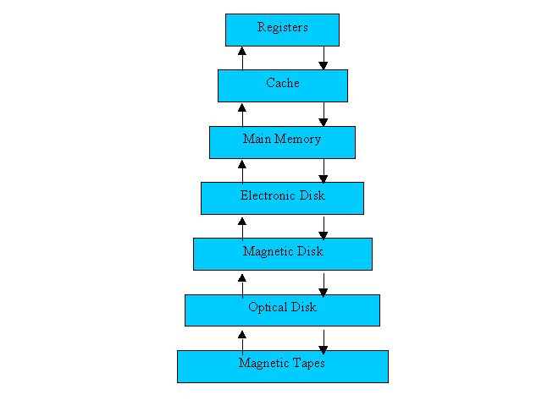
The Storage Hierarchy
Smaller, Faster
  Main memory (RAM) for currently used data.
  Disk for the main database (secondary storage).
  Tapes for archiving older versions of the data (tertiary storage).
Bigger, Slower
3-<number>

Slide 75
Disks and Files
DBMS stores information on disks.
This has major implications for DBMS design!
  READ: transfer data from disk to main memory (RAM).
  WRITE: transfer data from RAM to disk.
  Both are high-cost operations, relative to in-memory operations, so must be planned carefully!
3-<number>

Slide 76
Components of a Disk
Spindle
Disk head
Tracks
The arm assembly is moved in or out to position a head on a desired track.
Tracks under heads make a cylinder (imaginary!).
Sector
Arm movement
Platters
Arm assembly
Block size is a multiple
of sector size (which is fixed).

Slide 77
Disks
Secondary storage device of choice.
Main advantage over tapes: random access vs. sequential.
Data is stored and retrieved in units called disk blocks or pages.
Unlike RAM, time to retrieve a disk block varies depending upon location on disk.
  Therefore, relative placement of blocks on disk has major impact on DBMS performance!
3-<number>

Slide 78
Accessing a Disk Page
Time to access (read/write) a disk block:
  seek time (moving arms to position disk head on track)
  rotational delay (waiting for block to rotate under head)
  transfer time (actually moving data to/from disk surface)
Seek time and rotational delay dominate.
  Seek time varies between about 0.3 and 10msec
  Rotational delay varies from 0 to 4msec
  Transfer rate around 0.08msec
Key to lower I/O cost: reduce seek/rotation delays! Hardware vs. software solutions?
3-<number>

Slide 79
Index and index structure
Index is
Mechanism for efficiently locating rows without having to scone entire table. Ex author catalog in library
Based on a search key: rows having a particular value for the search key attributes can be quickly located.
Candidate key-set of attributes, quarantines uniqueness.
Search key:- sequence of attributes, does not guarantee uniqueness.
This minimize the no of disk access required or it’s the way of optimizing the performance of database
3-<number>

Slide 80
Structure of index
Search Key - attribute to set of attributes used to look up records in a file.
An index file consists of records (called index entries) of the form
Index files are typically much smaller than the original file
Pointer- holds address of particular disk block where the key value can be found.
Two basic kinds of indices:
  Ordered indices: search keys are stored
  Hash indices: search keys are distributed uniformly across “buckets” using a “hash function”.
search-key
pointer
3-<number>

Slide 81
Index Evaluation Metrics
Access types supported efficiently.
  Equality searches – records with a specified value in an attribute.
  Range searches – records with an attribute value falling within a specified range
Access time-time to find and use a files
Insertion time- time to push new record
Deletion time-time to delete from record
Space overhead- how much extra byte need for the index itself.
3-<number>

Slide 82
Classification of Indexing
In an ordered index, index entries are stored sorted on the search key value
  Eg. Author catalog in library
Primary index: in a sequentially ordered file, the index whose search key specifies the sequential order of the actual file. Also called clustering index.
Index entry is created for first record of each block
No of index entries= no of blocks
Secondary index: an index whose search key specifies an order different from the sequential order of the file. Also called non-clustering index. Number of entry in index file = number of entry in main file
3-<number>

Slide 83

Primary Dense Index Files
Dense index — Index record appears for every search-key value in the file. Or
every entry for possible search key values. Faster but it requires more space to store index itself.
E.g. index on ID
3-<number>

Slide 84

Dense Index Files (Cont.)
Dense index on dept_name, with instructor file sorted on dept_name
Don’t have a pointer to every records but one which has for search key
3-<number>

Slide 85

Primary Sparse Index Files
Sparse Index: contains index records for only some search-key values
To locate a record with search-key value K :
  Find index record with largest search-key value < K
  Search file sequentially starting at the record to which the index record points
You reach to the nearest record the follow pointer.
3-<number>
Notes:
Let searching 12121 go to index then 12121 is greater than first one but less than the second one

Slide 86
Sparse Index Files (Cont.)
Compared to dense indices:
  Less space and less maintenance overhead for insertions and deletions.
  Generally slower than dense index for locating records.
Good tradeoff: sparse index with an index entry for every block in file, corresponding to least search-key value in the block.
3-<number>

Slide 87
Problems with simple indexes
  Ex 100,000 entries
  If we create desen index it will have very large index
  If create sparse index we may have 50,000 sparse index.
  Solution: create multiple sparse index
3-<number>
Notes:
Let suppose 200 entiry ---we have 100 sparse index if use binary search log100 =~ 7
Single index- index and data directly communicating.
If the data is large size single index cant handle the index

Slide 88
Multilevel Index
If primary index does not fit in memory, access becomes expensive.
Solution: treat primary index kept on disk as a sequential file and construct a sparse index on it.
  outer index – a sparse index of primary index
  inner index – the primary index file
If even outer index is too large to fit in main memory, yet another level of index can be created, and so on.
Indices at all levels must be updated on insertion or deletion from the file.
3-<number>

Slide 89

Multilevel Index (Cont.)
3-<number>

Slide 90
Multilevel Index B⁺-Tree Index Files
All the data is stored in leaf node.
Every leaf is at the same level
Internal nodes stores just keys
All the leafs have pointer/links with each other for faster accesses like link list
Keys are used for directing a search to the proper key
There is threshold level(M)= max no of elements at a node.
3-<number>

Slide 91
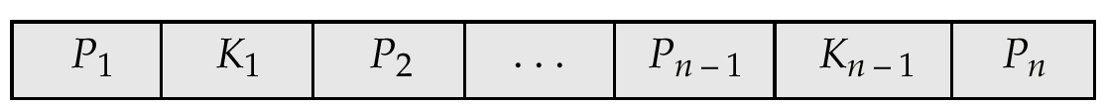
B⁺-Tree Node Structure
Typical node
  K_{i} are the search-key values
  P_{i} are pointers to children or pointers to records (for leaf nodes).
The search-keys in a node are ordered
K₁ < K₂ < K₃ < . . . < K_{n–1}
3-<number>

Slide 92
B⁺-Tree Node Structure
Advantage of B⁺-tree index files:
  Automatically reorganizes itself with small, local changes, in the time of insertions and deletions.
  Reorganization of entire file is not required to maintain performance.
Disadvantage of B⁺-trees:
  Extra insertion and deletion overhead, space overhead.
  B⁺-trees are used extensively
3-<number>

Slide 93
B⁺-Tree Node Structure
Internal nodes:
  Internal (non-leaf) nodes contain at least ⌈n/2⌉ pointers, except the root node.
  At most, an internal node can contain n pointers
Leaf nodes:
  Leaf nodes contain at least ⌈n/2⌉ record pointers and ⌈n/2⌉ key values.
  At most, a leaf node can contain n record pointers and n key values.
  Every leaf node contains one block pointer P to point to next leaf node and forms a linked list
3-<number>

Slide 94
B+ Tree Insertion
B+ tree are filled from bottom and each entry is done at the leaf node.
  If a leaf node overflows −
    Split node into two parts.
    Partition at i = ⌊(m + 1)/2⌋.
    First i entries are stored in one node.
    Rest of the entries i + 1 on wards are moved to a new node.
    i^{th} key is duplicated at the parent of the leaf.
3-<number>

Slide 95
B+ Tree Insertion
If a non-leaf node overflows −
  Split node into two parts.
  Partition the node at i = ⌈m + 1/2⌉.
  Entries up to i are kept in one node.
  Rest of the entries are moved to a new
3-<number>

Slide 96
B+ Tree node structure
A B
Values>=A &&<B
Values <A
Valuues >=B
3-<number>

Slide 97
B+ Tree Deletion
B+ tree entries are deleted at the leaf nodes.
The target entry is searched and deleted.
  If it is an internal node, delete and replace with the entry from the left position.
After deletion, underflow is tested,
  If underflow occurs, distribute the entries from the nodes left to it.
If distribution is not possible from left, then
  Distribute from the nodes right to it.
If distribution is not possible from left or from right, then
→ Merge the node with left and right to it.
3-<number>

Slide 98
Rules for Constructing a B+ Tree
Key values are max node of elements in the node
The number of key values contained in a non-leaf node is 1 less than the number of pointers
So if n is the order key is M=n-1.
If the tree has order n, the number of occupied key values in a leaf node must be between (n-1)/2 and n-1.
If (n-1)/2 is not an integer, round up to determine the minimum number of occupied key values.
The tree must be balanced, that is, every path from the root node must have the same length.
3-<number>

Slide 99
Rules for Constructing a B+ Tree
Example n=5
Node | Min Node | Max Node | Min Node | Max Node
Root | 1 |  | 1
Internal node | N/2 | N | 3 | 5
Leaf node | N/2 | N-1 | 3 | 4
3-<number>

Slide 100
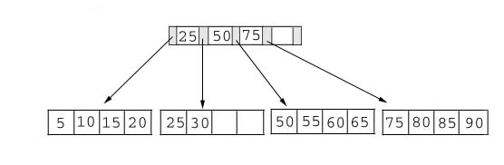
Searching
Since no structure change in a B+ tree during a searching process, so just compare the key value with the data in the tree, then give the result back.
For example: find the value 45 and 15 in below tree.
3-<number>

Slide 101
Searching
Result:
1. For the value of 45, not found.
2. For the value of 15, return the position where the pointer located.
3-<number>

Slide 102
Insertion
Since insert a value into a B+ tree may cause the tree unbalance, so rearrange the tree if needed.
Example #1: insert 28 into the below tree.
25 28 30
3-<number>

Slide 103
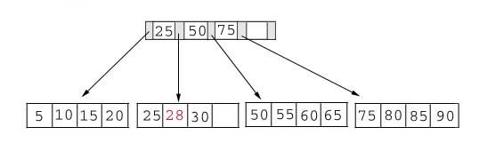
Insertion
Result:
3-<number>

Slide 104
Insertion
Example #2: insert 70 into below tree
3-<number>

Slide 105
Insertion
Process: split the tree
50 55 60 65 70
50 55
60 65 70

Slide 106
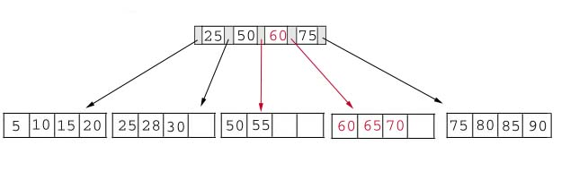
Insertion
Result: chose the middle key 60, and place it in the index page between 50 and 75.
3-<number>

Slide 107
Insertion
Exercise: add a key value 95 to the below tree.
75 80 85 90 95
75 80
85 90 95
25 50 60 75 85
3-<number>

Slide 108
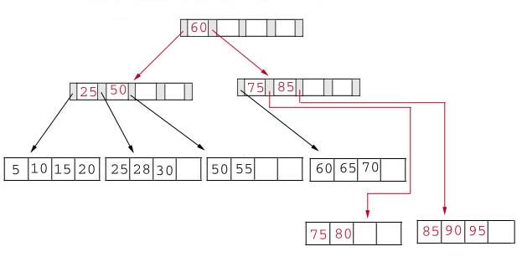
Insertion
Result: again put the middle key 60 to the index page and rearrange the tree.
3-<number>

Slide 109
Deletion
Same as insertion, the tree has to be rebuild if the deletion result violate the rule of B+ tree.
Example #1: delete 70 from the tree
This is OK.
60 65
3-<number>

Slide 110
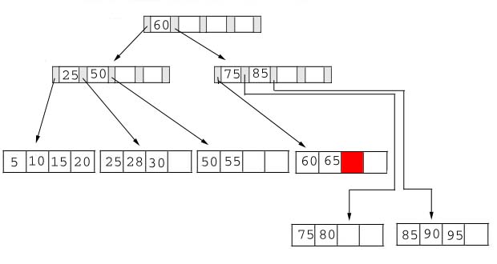
Deletion
  Result:
3-<number>

Slide 111
Deletion
Example #2: delete 25 from below tree, but 25 appears in the index page.
But…
28 30
This is OK.
3-<number>

Slide 112
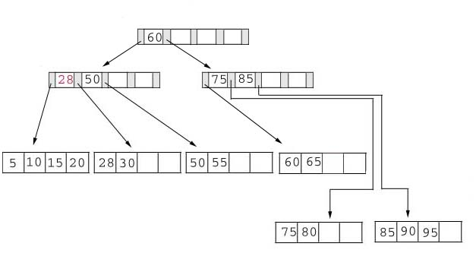
Deletion
Result: replace 28 in the index page.
Add 28
3-<number>

Slide 113
Deletion
Example #3: delete 60 from the below tree
65
50 55 65
3-<number>

Slide 114
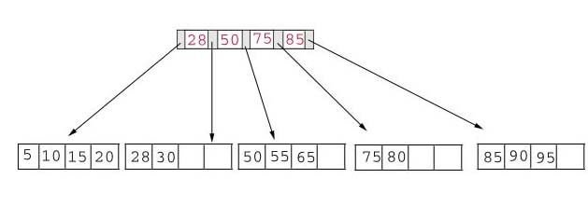
Deletion
Result: delete 60 from the index page and combine the rest of index pages.
3-<number>

Slide 115
Example 1
Create B +Tree for the following data.
Insert: 50,75,100,120
M=2
3-<number>

Slide 116
Insert 50,75
50* 75*
a
3-<number>

Slide 117
Insert 100
* 75 *
a
b
c
* 50 *
* 75 *100*
Node a splits creating 2 children: b and c
3-<number>

Slide 118
Insert 8
* 75 *
* 50 *
* 100 *
* 75 *
100* 120 *
3-<number>

Slide 119
Exercise 1
B+Tree of order n=4 then key=3
Insert: 2,4,7,10,17,21,28
3-<number>

Slide 120
Exercise 1
B+Tree of order n=6
Insert: 10,20,30,40,50,60,70,80,90
M=5
3-<number>

Slide 121
Exercise 2
B+Tree of order n=4
Insert: 20,15,5,1,3,9,2
M=3
3-<number>

Slide 122
Exercise 3
B+ Tree of order 3
Insert: 5,8,4,16,23,10,15
M=2
3-<number>

Slide 123
Conclusion
For a B+ Tree:
It is easy to maintain it’s balance.
The searching time is short than most of other types of trees.
3-<number>

Slide 124
Query Execution Plans
An execution plan for a relational algebra query consists of a combination of the relational algebra query tree and information about the access methods to be used for each relation as well as the methods to be used in computing the relational operators stored in the tree.
Materialized evaluation: the result of an operation is stored as a temporary relation.
Pipelined evaluation: as the result of an operator is produced, it is forwarded to the next operator in sequence.
3-<number>

Slide 125
Evaluation
evaluate multiple operations in a plan
materialization
pipelining
π_{name}
σ_{coursename=Advanced DBs}
_{courseid; index-nested loop}
_{cid; hash join}
course
student
takes

Slide 126
Materialization
create and read temporary relations
create implies writing to disk
  more page writes
π_{name}
σ_{coursename=Advanced DBs}
_{courseid; index-nested loop}
_{cid; hash join}
course
student
takes

Slide 127
Pipelining (1/2)
creating a pipeline of operations
reduces number of read-write operations
implementations
  demand-driven - data pull
  producer-driven - data push
π_{name}
σ_{coursename=Advanced DBs}
_{ccourseid; index-nested loop}
_{cid; hash join}
course
student
takes

Slide 128
Pipelining (2/2)
can pipelining always be used?
any algorithm?
cost of R S
  materialization and hash join: B_{R} + 3(B_{R}+B_{S})
  pipelining and indexed nested loop join: N_{R} * HT_{i}
_{courseid}
pipelined
materialized
R
S
_{cid}
σ_{coursename=Advanced DBs}
student
takes
course

